Slide 1

Welcome to Data Science Online Bootcamp
Week#5_Day#2

Slide 2

Learning Objectives
Difference between Classification and Regression
Classification Algorithms & Model Evaluation Metrics
Which evaluation metrics to use when?

Slide 3
Disclaimer
We haven’t taught all the algorithms as the Bootcamp was of 5 weeks and we wanted learners to have a good grasp on the concepts that are being taught and not overwhelm them with all the concepts available. Once you know how to handle data and build models, you can easily build different kinds of models.
Through this module, we’ll be providing material around some of the popular algorithms. In addition, we will sharing some more resources soon.

Slide 4
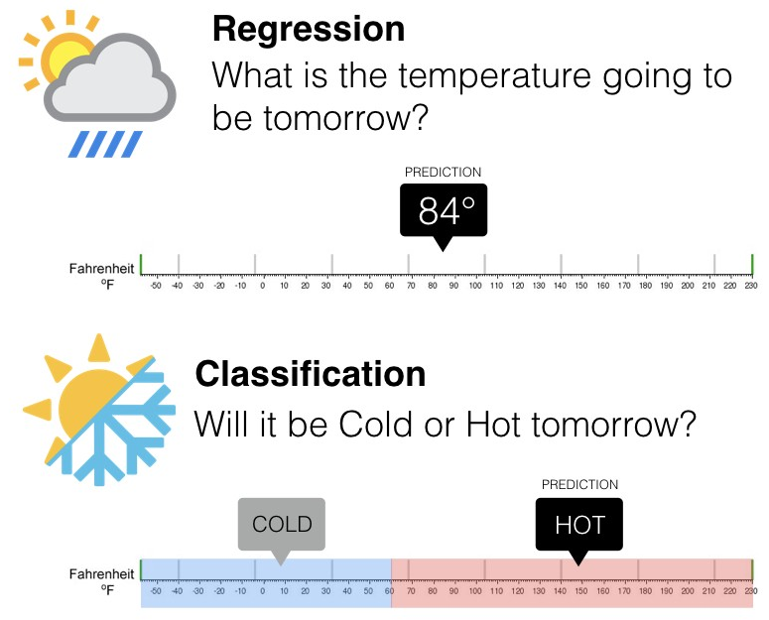
Classification vs Regression
In order to decide whether to use a regression or classification model, the first questions you should ask yourself is:
Does your target variable have a continuous value or is it discrete (binary or multi-class)?

Slide 5
Regression
If your answer is continuous values, you’re dealing with Regression.
This means that if you’re trying to predict quantities like height, income, price, or scores, you should be using a model that will output a continuous number.
So if your objective is to determine tomorrow’s temperature, you should use a regression model.

Slide 6
Classification
Let’s come to the second case where if you can clearly see that the target variable is divided into classes. You’ll be using Classification here.
When the number of classes is 2, it is known as Binary Classification.
Eg. Will it be hot or cold tomorrow is a binary classification problem with 2 classes: Hot and Cold.
When it is more than 2, it is known as Multi Class Classification.
Eg. Classifying movies in Good, Average or Bad according to reviews.

Slide 7
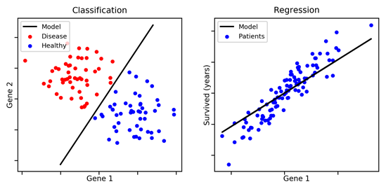
Classification vs Regression
It’s important to understand the characteristics of your target variable before you begin running models and forming predictions.

Slide 8
Classification Algorithms

Slide 9
Types of Classification Algorithms
Logistic Regression
Decision Trees (DecisionTreeClassifier)
Random Forest (RandomForestClassifier)
Other Algorithms
Naive Bayes Classifier
Support Vector Machines
K Nearest Neighbors
And many more….

Slide 10
Logistic Regression
Logistic Regression is one of the basic and popular algorithm to solve a classification problem(when the dependent variable(target) is categorical).
Regression in 'Logistic Regression', comes from the fact that its underlying technique is quite the same as Linear Regression. The term “Logistic” is taken from the Logit/Sigmoid function that is used in this method of classification.
For example,
To predict whether an email is spam (1) or (0)
Whether the tumor is malignant (1) or not (0)
Logistic Regression Module:
https://docs.google.com/presentation/d/10mkWll_9s8LkZpy-SzRWQjFr2ay6VppgpjkBVs2HSvM/edit#slide=id.g88e3151951_0_51

Slide 11

2. Decision Trees for Classification -Classification Trees

Slide 12
Decision Trees
Classification tree methods (i.e., decision tree methods) are recommended when the task contains classifications or predictions of outcomes, and the goal is to generate rules that can be easily explained and translated into SQL or a natural query language.
A Classification tree labels, records, and assigns variables to discrete classes. A Classification tree can also provide a measure of confidence that the classification is correct.
Module on Decision Trees:
https://docs.google.com/presentation/d/1BCwLdFQqFLHR2-7APyoWh5u1b6Jo3wq17nj-8s2H_mg/edit#slide=id.p1

Slide 13
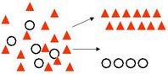
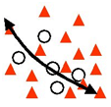
CART
You might encounter the term ‘CART’ while building ML models. It’s actually nothing new but the same old Decision Tree you built your first model with.
CART = Classification and Regression Trees, an umbrella term for:
Classification Trees: where the target variable is categorical and the tree is used to identify the "class" within which a target variable would likely fall into.
Regression Trees: where the target variable is continuous and tree is used to predict it's value.

Slide 14
Resources on Decision Tree Classification
Implementation of Decision Tree Classification: https://www.datacamp.com/community/tutorials/decision-tree-classification-python
Notebooks:

Slide 15
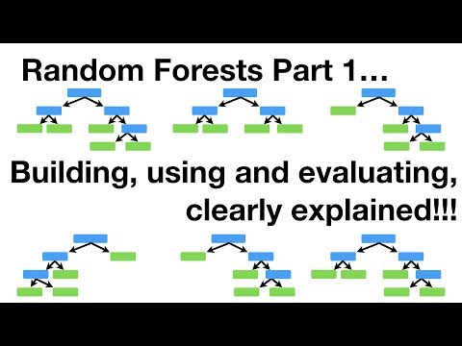
3. Random Forest for classification - Classification Forest

Slide 16
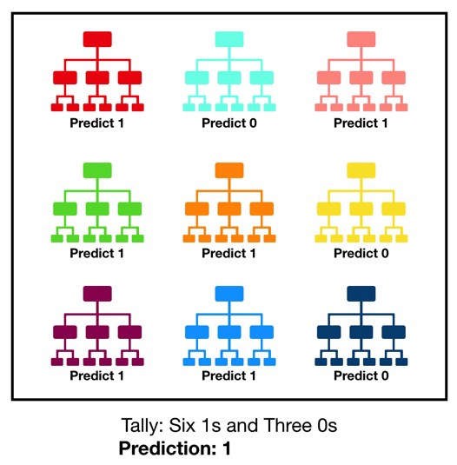
Random Forest
It is an ensemble tree-based learning algorithm. The Random Forest Classifier is a set of decision trees from randomly selected subset of training set. It aggregates the votes from different decision trees to decide the final class of the test object.
Module for Random Forest and Ensemble Models:
https://docs.google.com/presentation/d/18pyGEZGkEwinktUyZNlhAPAgJMS04tUIIcoyhQFefRw/edit#slide=id.p1

Slide 17
Resources on Random Forest Classification
Implementation of Random Forest Classification: https://www.datacamp.com/community/tutorials/random-forests-classifier-python
Notebooks: https://github.com/dphi-official/ML_Models/tree/master/Random_Forest

Slide 18
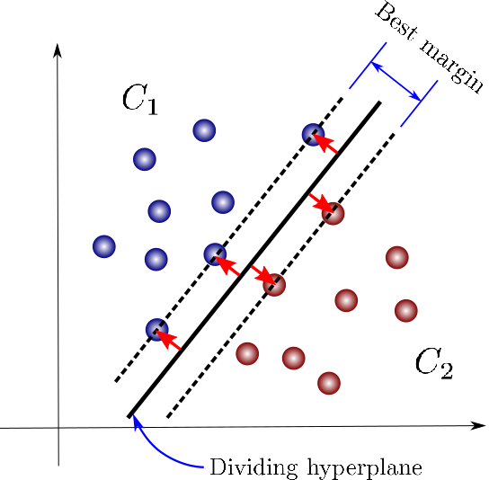
Other Regression Algorithms
1. SUPPORT VECTOR MACHINE(SVM):
The objective of SVMs is to categorize data into two classes. It does so by finding a separating hyperplane(decision boundary), where the distance between itself and the closest data points for both categories is maximized.
Look at how the hyperplane lies exactly between
the nearby blue and red points
(maximising the margin)
Simple Visual Explanation of SVM:
https://medium.com/towards-artificial-intelligence/support-vector-machine-svm-a-visual-simple-explanation-part-1-a7efa96444f2

Slide 19
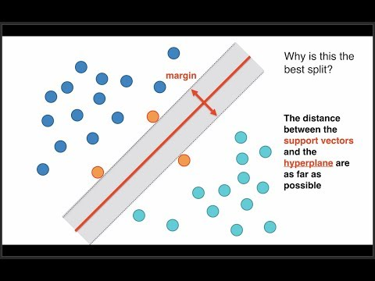
Other Regression Algorithms
2. SUPPORT VECTOR MACHINE(SVM):

Slide 20
Other Regression Algorithms
2. K NEAREST NEIGHBORS (KNN)
The KNN algorithm assumes that similar things exist in close proximity. In other words, similar things are near to each other.
Have you noticed Amazon showing you “Customers who bought this item also bought..”. The basis of such a recommendation system is an algorithm like KNN.

Slide 21
Other Classification Algorithms
3. NAIVE BAYES CLASSIFIER:
Naive Bayes is the most straightforward and fast classification algorithm, which is suitable for a large chunk of data.
Naive Bayes classifier is successfully used in various applications such as spam filtering, text classification, sentiment analysis, and recommender systems.
It uses Bayes theorem of probability for prediction of unknown class.
Advantages:
This algorithm requires a small amount of training data to estimate the necessary parameters. Naive Bayes classifiers are extremely fast compared to more sophisticated methods.
Disadvantages: Naive Bayes is known to be a bad estimator.
Naive Bayes Classification using Scikit-learn:
https://www.datacamp.com/community/tutorials/naive-bayes-scikit-learn

Slide 22

Other Regression Algorithms
3. K NEAREST NEIGHBORS (KNN)

Slide 23
MUST READ
Classification Algorithms with their Python Codes:
https://analyticsindiamag.com/7-types-classification-algorithms/

Slide 24
Evaluating a Classification Model

Slide 25
Classification Model Evaluation
Evaluation Metrics
Accuracy (Not in case of imbalanced classes)
Confusion Matrix
Precision
Recall/ Sensitivity
Specificity
F1 Score
AUC ROC

Slide 26



Accuracy
Classification Accuracy is what we usually mean, when we use the term accuracy. It is the ratio of number of correct predictions to the total number of input samples.
Actual Labels:
Task at hand - Separate Yellow and pink balls
Predicted Labels:
Colors predicted by our model
Correctly predicted = 4
Total Predictions = 6
Accuracy = 4/6 = 66.7%

Slide 27
Why not Accuracy?
Accuracy is very important, but it might not be the best metric all the time. Let’s look at why with an example -:
Let’s say we are building a model which predicts if a transaction is fraudulent or not
Let’s imagine, we build a basic model which always predicts that a transaction is not fraudulent. Guess what would be the accuracy of this model?
~99% !! (You may ask why? Well, less than 1% transactions are usually fraudulent and there is a huge class imbalance. So even if you fit a wrong model that always predicts a transaction to be not fraudulent, the accuracy will remain 99% owing to class imbalance)
Impressive, right? Well, the probability of a bank buying this model is absolute zero. 😆
In a problem where there is a large class imbalance, a model can predict the value of the majority class for all predictions and achieve a high classification accuracy.
While our model has a stunning accuracy, this is an apt example where accuracy is definitely not the right metric.

Slide 28
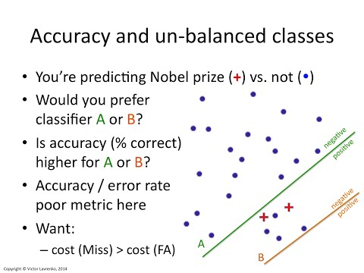
Why not Accuracy?
Watch till 1 min 14 secs to understand why accuracy is bad metric for model performance

Slide 29
Evaluating the Performance of Logistic Regression model
Logistic Regression employs different sets of metrics than Linear Regression. Here, we deal with probabilities and categorical values.
In the following slides, we describe a few of the evaluation metrics used for Logistic Regression:

Slide 30
Is confusion matrix confusing or it resolves the confusion?
You decide!

Slide 31
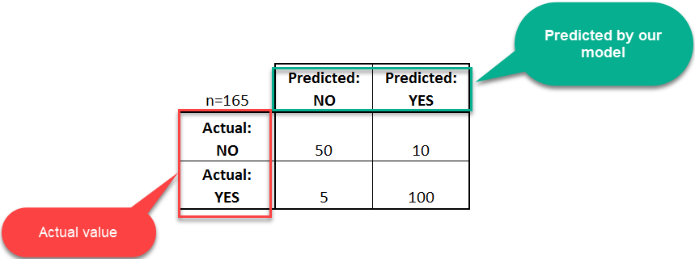
Confusion Matrix
A confusion matrix is a table that is often used to describe the performance of a classification model (or "classifier") on a set of test data for which the true values are known. The confusion matrix itself is relatively simple to understand, but the related terminology can be confusing.
Let's start with an example confusion matrix for a binary classifier for disease prediction (though it can easily be extended to the case of more than two classes):

Slide 32
Confusion Matrix
Let's now define the most basic terms, which are whole numbers (not rates):
true positives (TP): These are cases in which we predicted yes (they have the disease), and they do have the disease.
true negatives (TN): We predicted no, and they don't have the disease.
false positives (FP): We predicted yes, but they don't actually have the disease. (Also known as a "Type I error.")
false negatives (FN): We predicted no, but they actually do have the disease. (Also known as a "Type II error.")
I know these seem hard to memorise. One thing that has helped me remember these are by putting it in a better way:
false positives = falsely classified as being positive.

Slide 33
Confusion Matrix
This is a list of rates that are often computed from a confusion matrix for a binary classifier:
Precision: Correctly predicted as positives compared to total predicted as positives
Precision = TP/(TP+FP) = 100/110 = 0.91
Sensitivity/Recall: Correctly predicted as positives compared to total number of positives
= TP/(TP + FN) = 100/(100+5) = 0.95
Note: Mostly we have to pick one over other, it’s almost impossible to have both high Precision and Recall.
Specificity: Correctly predicted as negatives compared to total number of negatives = TN/(TN + FP) = 50/(50+10) = 0.83

Slide 34

Understanding Precision and Recall
Think about the search box on Amazon home page.
The precision is the proportion of relevant results( correctly predicted yes) in the list of all returned search results(total predicted yes).
The recall is the ratio of the relevant results( correctly predicted yes) returned by the search engine to the total number of the relevant results that could have been returned (total actual yes).

Slide 35
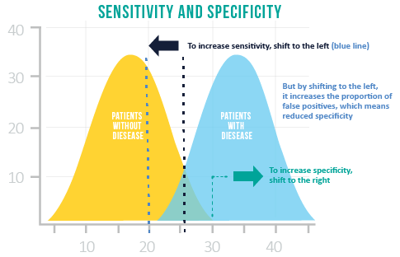
Choosing between Sensitivity and Specificity
Often, the sensitivity and specificity of a test are inversely related. Selecting the optimal balance of sensitivity and specificity depends on the objective of the problem that needs to be solved.
If correctly identifying positive class is important for us, then we should choose a model with higher Sensitivity. However, if correctly identifying negative class is more important, then we should choose specificity as the measurement metric.

Slide 36
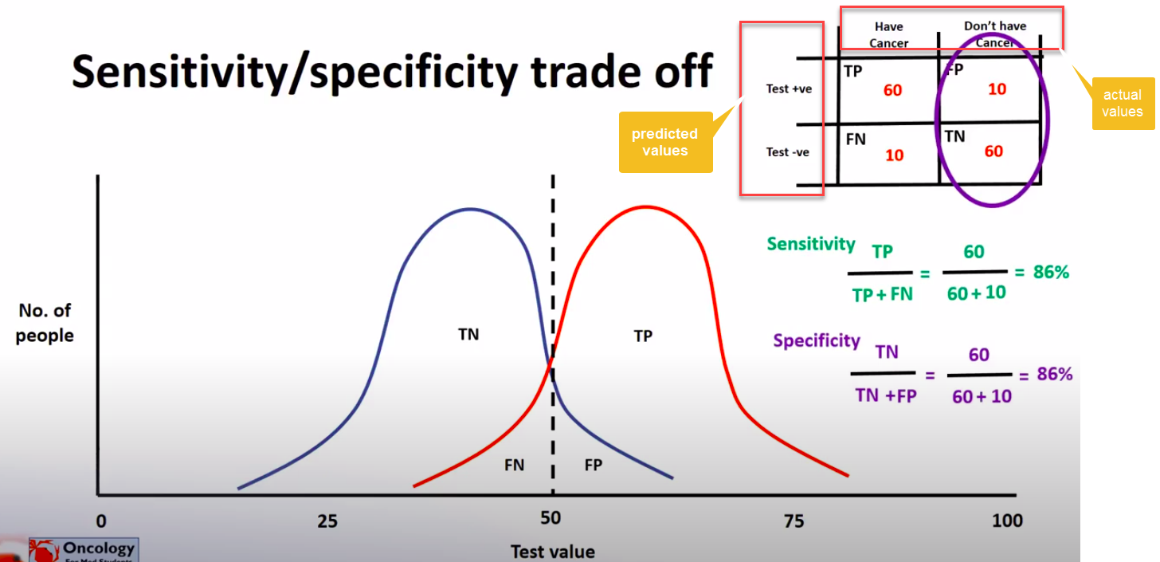
Sensitivity or Specificity - an example
Let’s say we are predicting if a patient has cancer or not. The default probability threshold is kept at 0.5 i.e
Class 0 (No cancer) – Below 0.5
Class 1 (Cancer) – Above 0.5

Slide 37
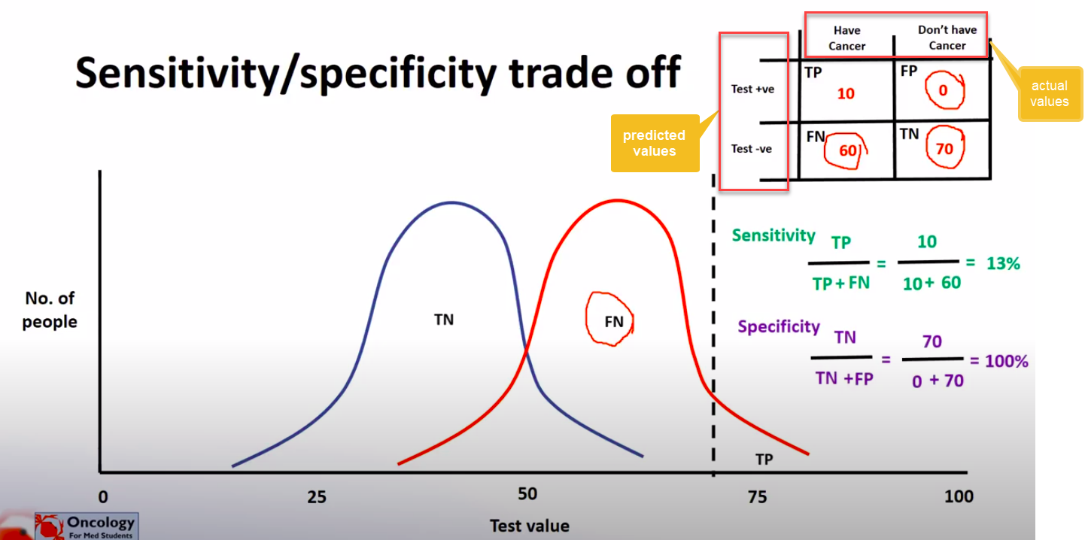
Case 1: Higher Specificity
Suppose we want to predict Class 1 (Ci.e patient has cancer) only if we are VERY confident. (To avoid giving the patient a shock and to avoid unnecessary treatment)
We can instead change this threshold to 0.7. Thus, we’ll tell someone they have cancer only if we think they have greater than or equal to 70% chance of having a cancer.
Look at the graph below. SInce the threshold has shifted to the right, so the number of people correctly guessed as having cancer have increased. Thus, the specificity has increased. ( We are being very specific with declaring patients with cancer).

Slide 38
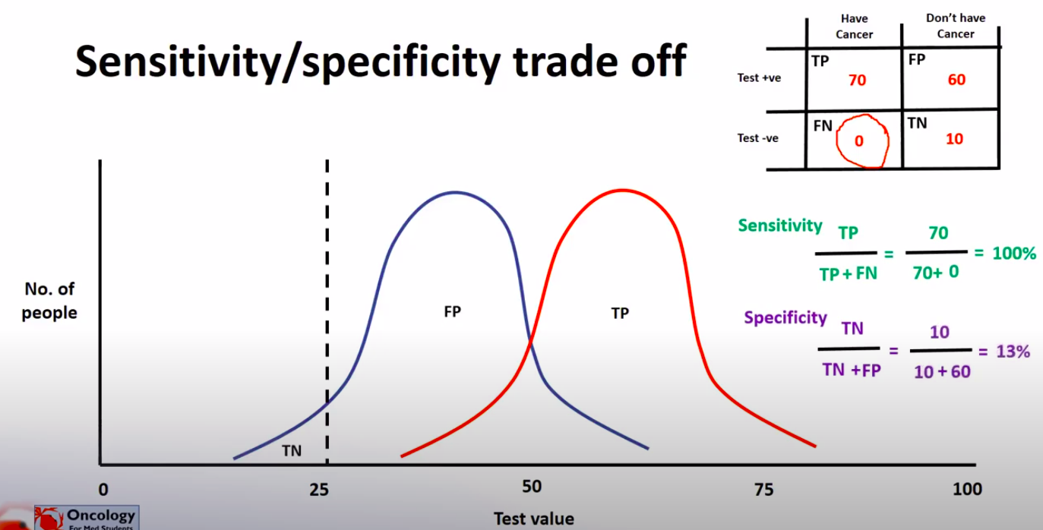
Case 2: Higher Sensitivity
Suppose we want to avoid missing too many cases of cancer ( avoid false negatives). If a person with cancer is told that he’s well, it can cause a delay in treatment and affect the health badly).
In this case we can set a lower threshold, say 0.25. Even if a patient has 25% chance of having cancer, we’ll inform him/her.
Looking at the graph you can see that the threshold has shifted to the left. Most of the people with cancer will be detected in advance in this case. We have completely (or almost) eliminated False Negatives. It will thus result in higher Sensitivity/ Recall. (We are being sensitive in detecting a disease i.e a really sensitive test).

Slide 39
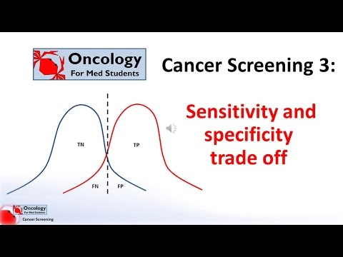
You can watch this video from 00:58 to 5:32 explaining the Sensitivity and Specificity trade off

Slide 40

Confusion Matrix
Talking about accuracy, our favourite metric!
Accuracy is defined as the ratio of correctly predicted examples by the total examples.
Accuracy: Overall, how often is the classifier correct?
= (TP+TN)/total = (100+50)/165 = 0.91
Remember, accuracy is a very useful metric when all the classes are equally important.
But this might not be the case if we are predicting if a patient has cancer. In this example, we can probably tolerate FPs but not FNs.
If a cancerous patient is wrongly reported as being fine, it can result in delaying of treatment. Which is not good!

Slide 41
Confusion Matrix
So you’ve already learnt how to calculate Precision and Recall and how changing the threshold can affect their values. (SImilar to Sensitivity, Specificity threshold)
But do we necessarily need to spend time on varying the threshold to get the perfect Precision and Recall? Or is there a way to choose this threshold automatically?
Let’s take 3 algorithms and try to find a metric for combining Precision and Recall.
How about taking an average of Precision and Recall? (P+R)/2
 | Precision (P) | Recall (R) | Average
Algorithm 1 | 0.5 | 0.4 | 0.45
Algorithm 2 | 0.7 | 0.1 | 0.4
Algorithm 3 | 0.02 | 1.0 | 0.51

Slide 42
F1 Score
Average tells us that Algorithm 3 is the best (highest value). Whereas Algorithm 3 is a dumb model that predicts y=1 each time and thus gives a recall of 1 (FN =0, TP=1).
That means average isn’t a good metric.
Researchers found a metric that solves our purpose: The F1 Score!

Slide 43
F1 Score
Let’s apply F1 Score to our problem:
The F1 score tells us that Algorithm 1 is the best (highest F1 Score).
For F1 Score to be large, both P and R need to be large.
It’ll be highest(1) when both P and R are 1
Accuracy can be used when the class distribution is similar while F1-score is a better metric when there are imbalanced classes.
 | Precision (P) | Recall (R) | Average | F1 Score
Algorithm 1 | 0.5 | 0.4 | 0.45 | 0.444
Algorithm 2 | 0.7 | 0.1 | 0.4 | 0.175
Algorithm 3 | 0.02 | 1.0 | 0.51 | 0.0392

Slide 44


ROC (Receiver Operator Characteristic) Curve
An ROC curve is a commonly used way to visualize the performance of a binary classifier, meaning a classifier with two possible output classes.
It shows the performance of a classification model at all threshold values.
It plots 2 parameters:
True positive rate /Recall (TPR)
False Positive rate (FPR)

Slide 45
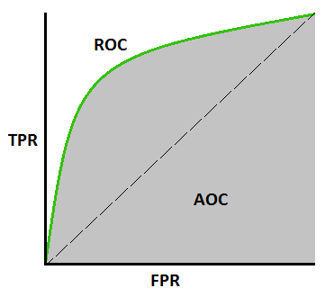
AUC Curve
AUC stands for "Area under the ROC Curve." That is, AUC measures the entire two-dimensional area underneath the entire ROC curve
AUC provides an aggregate measure of performance across all possible classification thresholds.

Slide 46

ROC and AUC Explained

Slide 47
Reading Material
MUST READ
An excellent article explaining Threshold, ROC and AUC in a simple manner: https://towardsdatascience.com/understanding-the-roc-and-auc-curves-a05b68550b69

Slide 48
Which metrics to use when?

Slide 49
Which metrics to use when?
This is an important question and we get used to learning these measures over time. Sharing some resources with you all so that it helps you understand what metrics to be used in the context of solving a regression problem.
5 Classification Metrics every data scientist must know
https://towardsdatascience.com/the-5-classification-evaluation-metrics-you-must-know-aa97784ff226
https://medium.com/usf-msds/choosing-the-right-metric-for-evaluating-machine-learning-models-part-2-86d5649a5428

Slide 50
Slide Download Link
You can download the slides here:
https://docs.google.com/presentation/d/1JbZ8wM3xt5p2rk8nh1iFhscXmGFTSl-ZvNQ2smpCyl0/edit?usp=sharing

Slide 51
That’s it for the day. Thank you!
Feel free to post any queries in the #help channel on Slack

